Slide 1
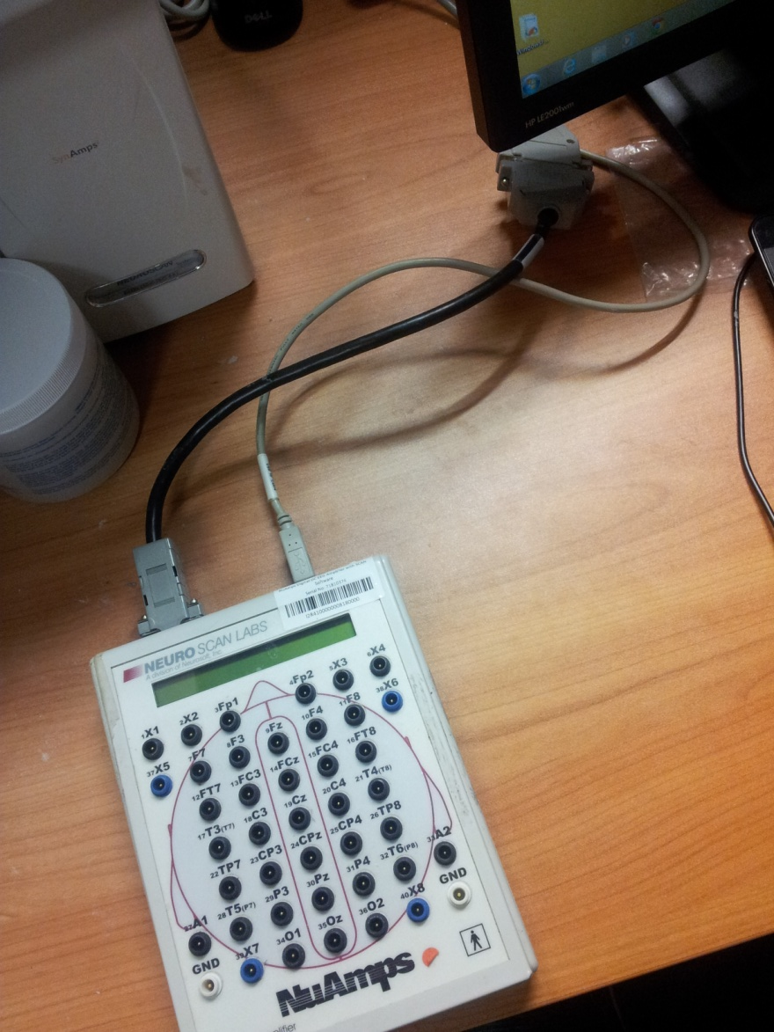
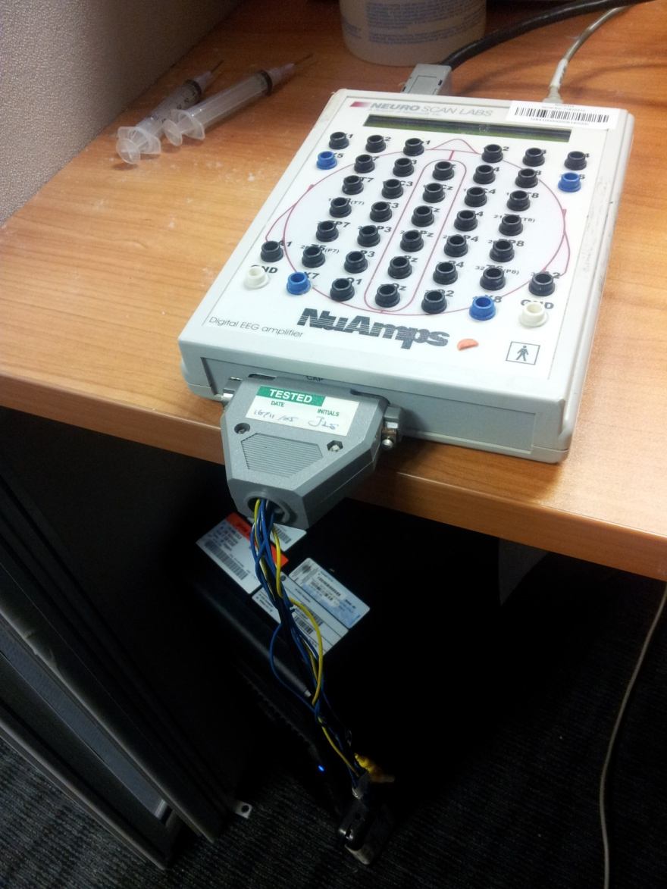

Slide 2

2
3
1

Slide 3
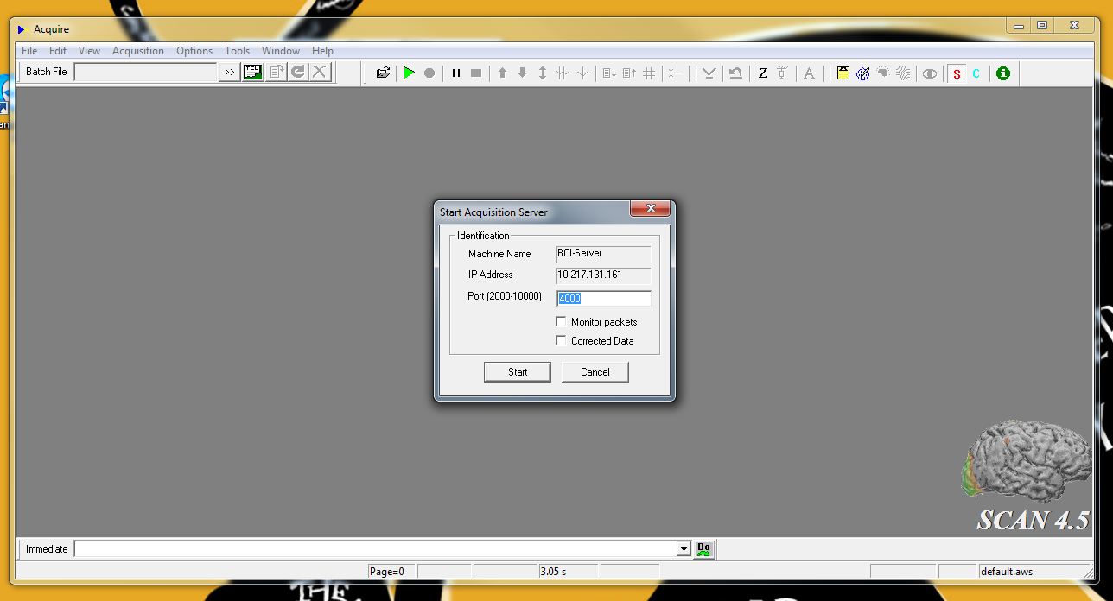
1
2

Slide 4
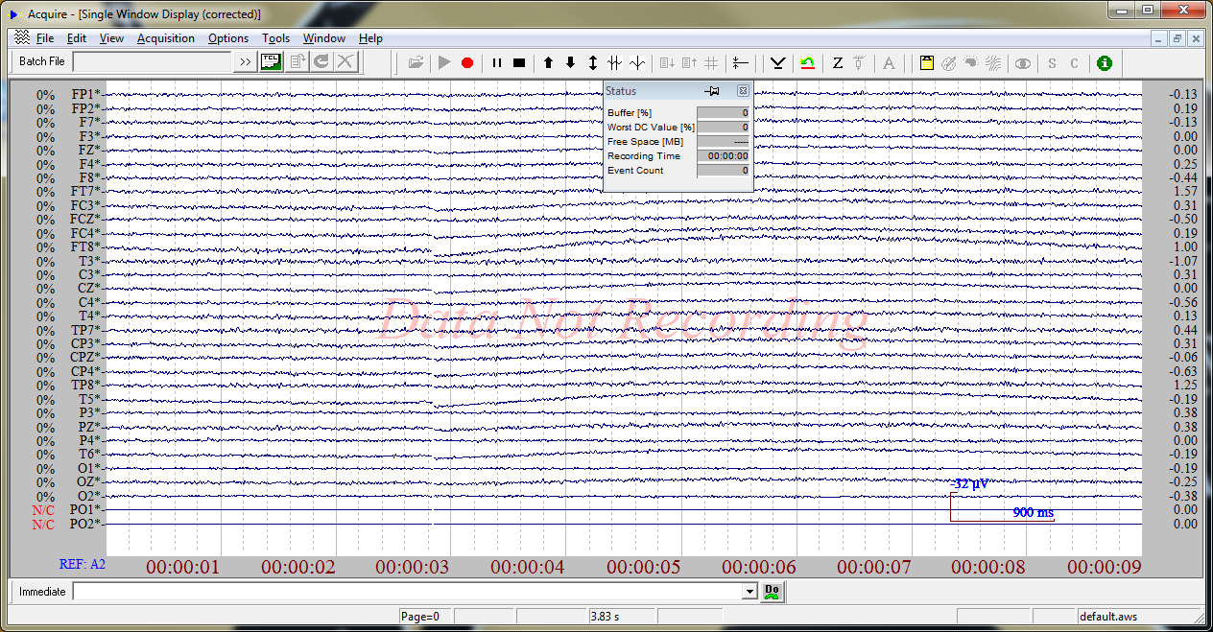
1

Slide 5
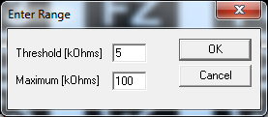
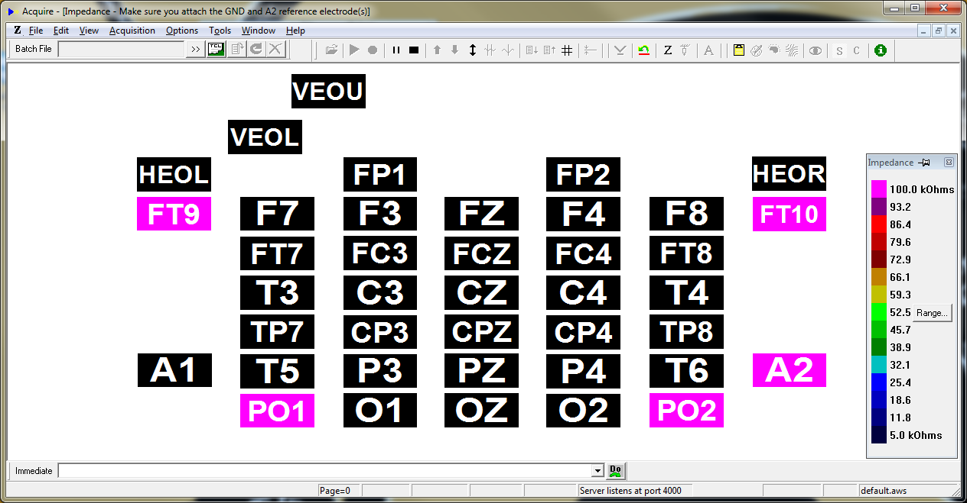
3
1
2

Slide 6
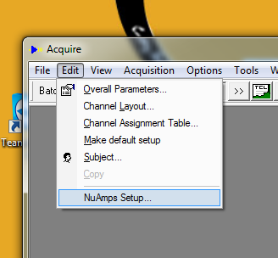
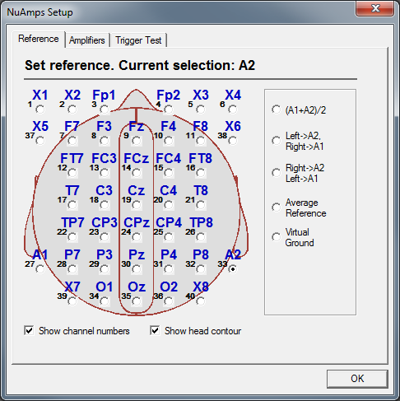
1
2

Slide 7
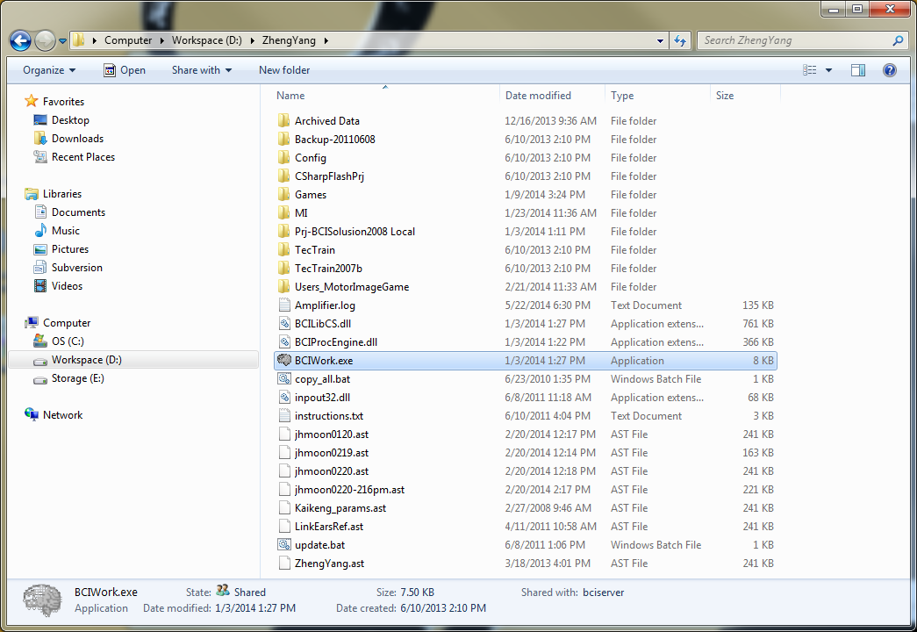
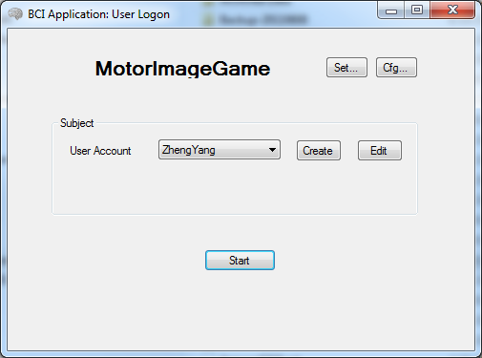
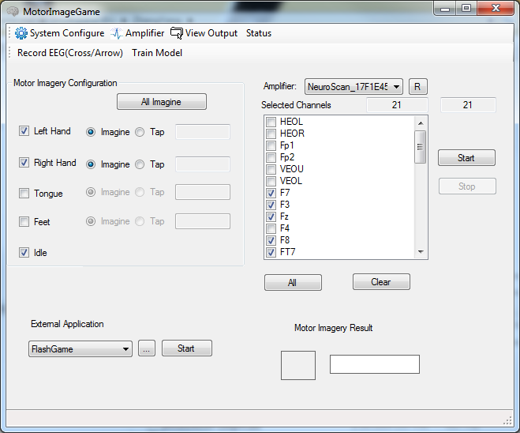
1
3
2

Slide 8
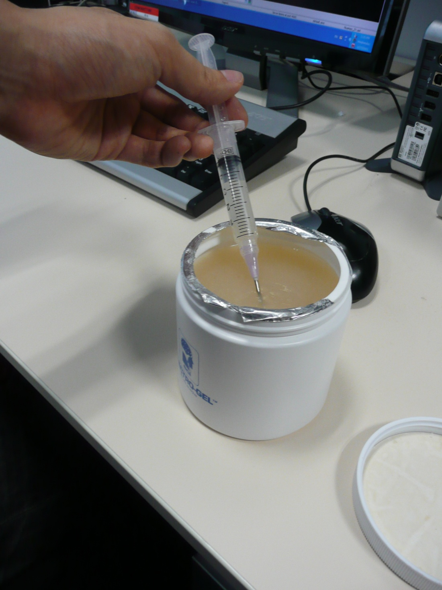
Preparation of Gel

Slide 9
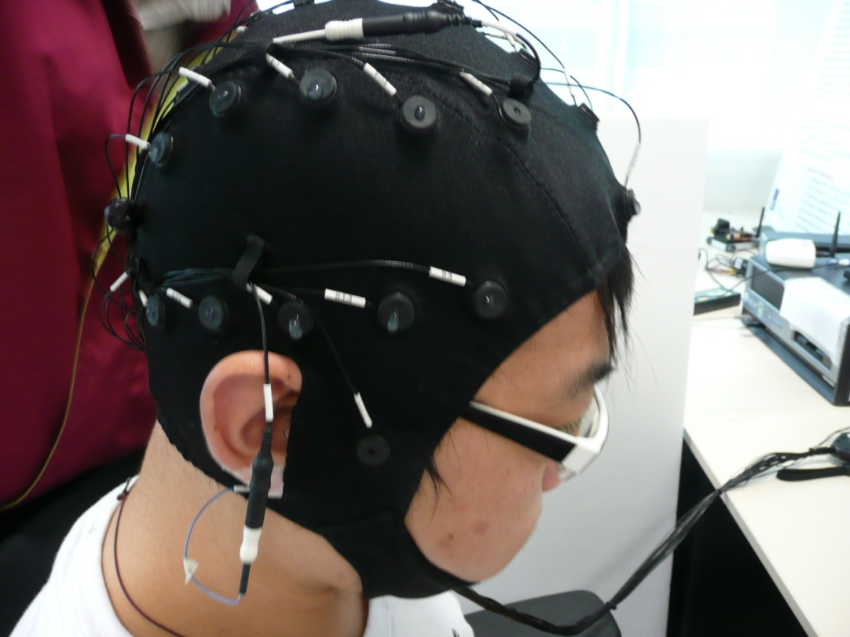
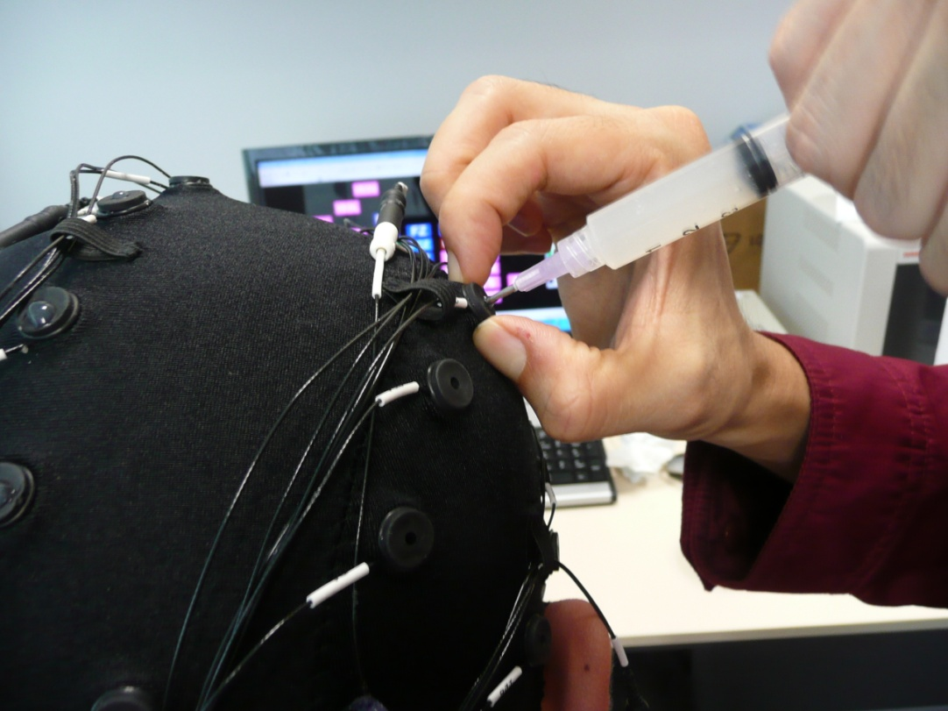
Electrode A2 on right earlobe
GND electrode on top
Fp1 and Fp2 to test whether cap is working
Followed by the rest of the electrodes
Lift up the electrode slightly
Inject gel inside
Release the electrode
Do NOT scrap the needle against the scalp

Slide 10
Clean Up
Put lukewarm water into container
Put cap into container
Bring to basin, put water into machine
Squirt away all gel from electrodes
Add shampoo into water, let it soak for 10 minutes
Pour away soapy water, wash away soap from cap, rinse in water for another 10 minutes
Wash and clean
Remove from container and hang to dry

